Slide 1
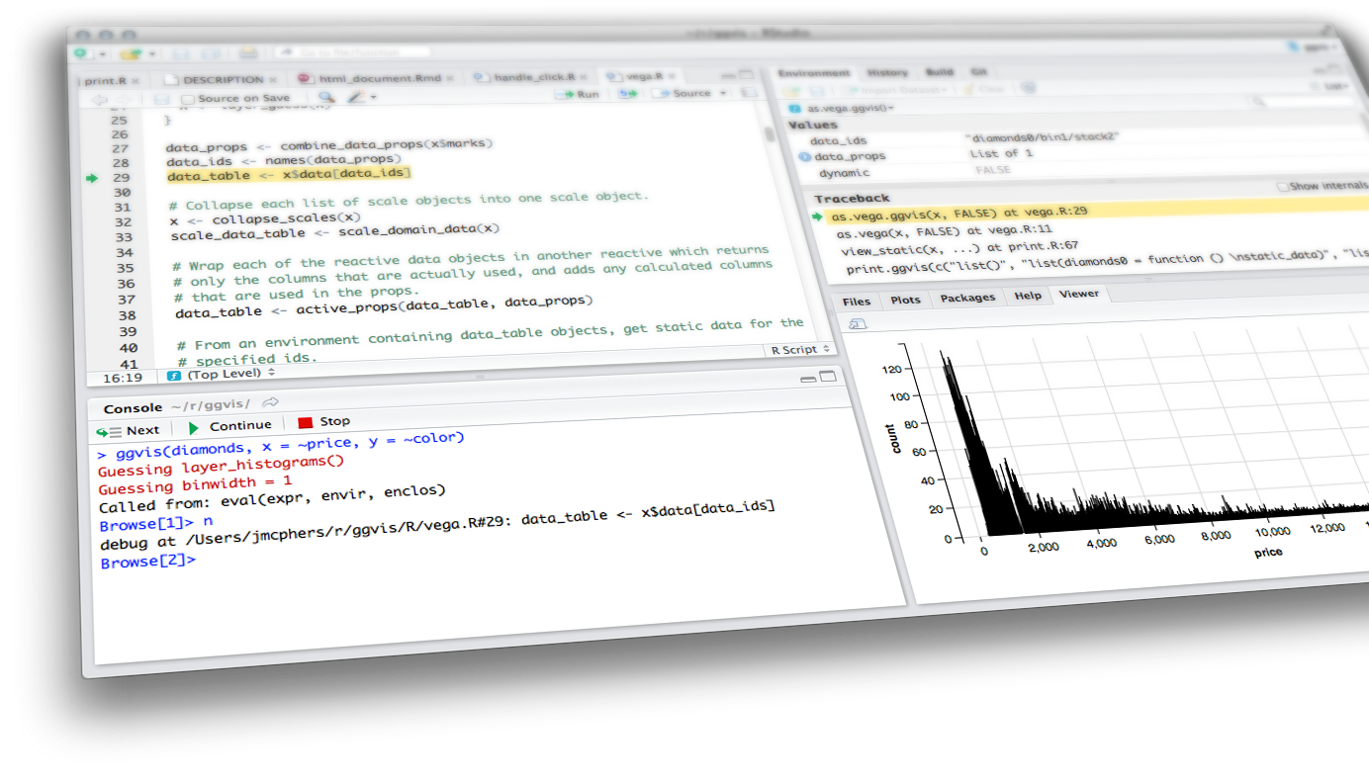

Leaflet & LeafletProxy
Shiny from

Slide 2
Motivation
Shapefiles in R
Leaflet
Basemaps
Lines
Points
Shapes
Legends & Colors
leaflet.extras
Heatmaps
Leaflet in Shiny
renderLeaflet
leafletOutput
What we know about reactivity
LeafletProxy
Observe
events

Slide 3
Leaflet
For interactive maps
Shiny from

Slide 4
Motivation

Slide 5
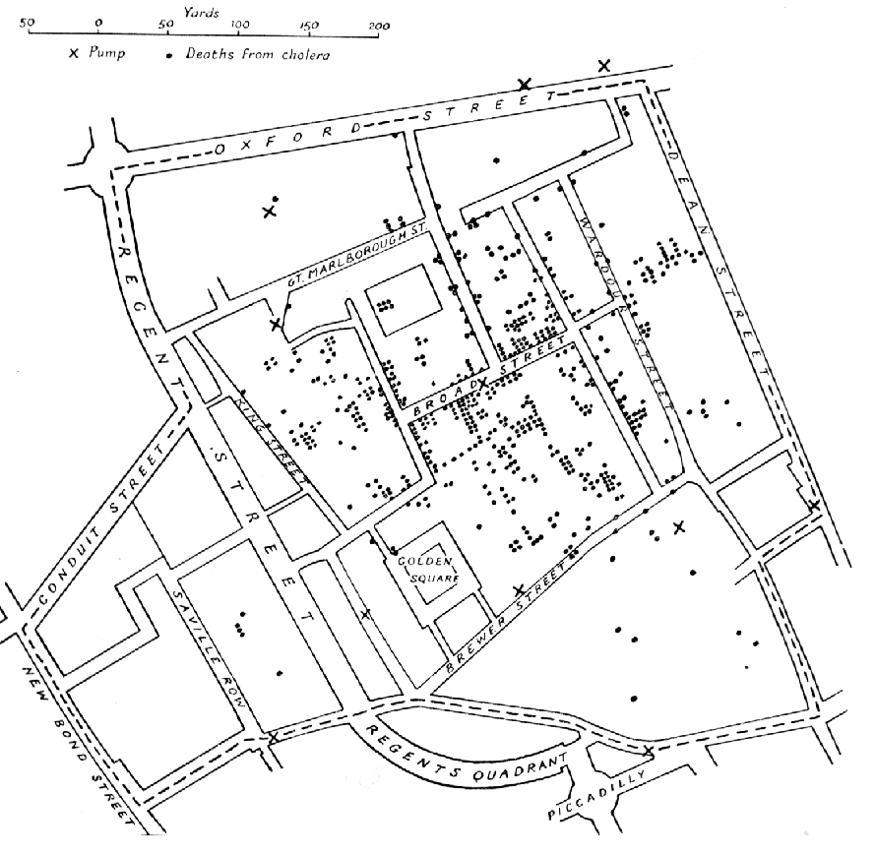
Map of the 1854 Cholera outbreak - John Snow

Slide 6
“‘I have the same problem’ is a famous last post in many forum-threads on the esri forum.”
–sebastian

Slide 7


Slide 8
“R and Leaflet are free and open-source, ArcMap is very much not.”
–Geoffrey Arnold

Slide 9
Shapefiles
In R

Slide 10
Packages
Install these packages:
rgdal: https://github.com/cran/rgdal/blob/master/inst/README
rgeos
sp
leaflet
leaflet.extras

Slide 11
What is leaflet?
R version of the Javavscript API of Leaflet
One of the ways to get interactive maps
Others include: tmap, mapview and plotly
Documentation: https://rstudio.github.io/leaflet/

Slide 12
Getting spatial data loaded into R

Slide 13
Loading spatial data
Sometimes your source data will be a data frame which you will need to join to spatial data, other times it will be included
It may also be a CSV with coordinates, in those instances no further cleaning needs to take place

Slide 14
demo
leaflet_examples.Rmd
Go to loading code chunk

Slide 15
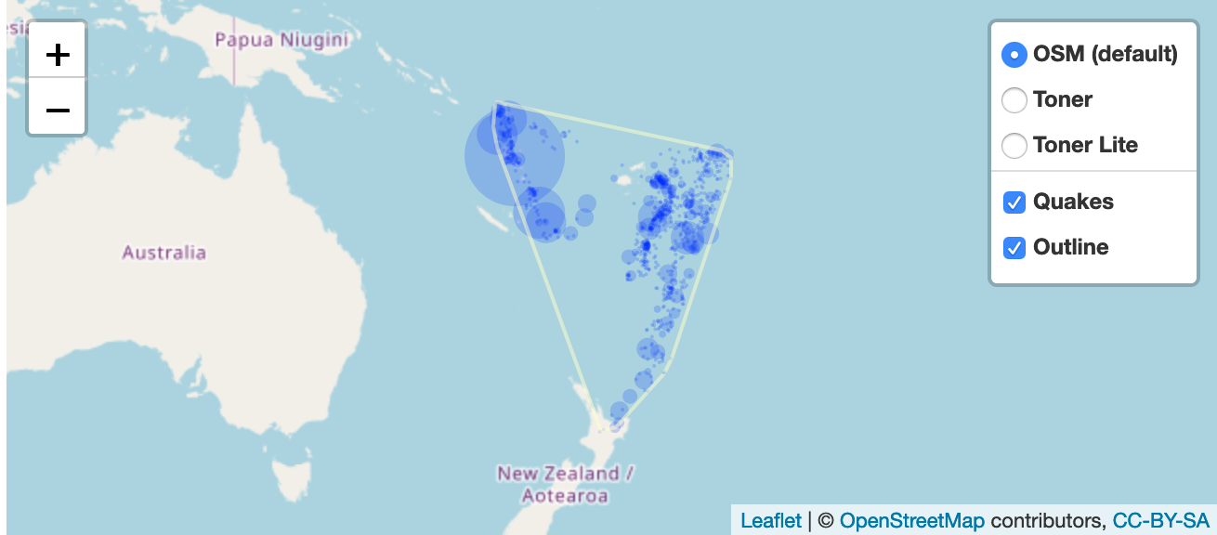
Group Controls
In leaflet you can add groups and give them a name.
Group names are what show up in the layer control
addProviderTiles(providers$Stamen.Toner, group = “Toner”) %>%
addLayersControl(
baseGroups = c("OSM (default)", "Toner", "Toner Lite"),
overlayGroups = c("Quakes", "Outline"),
options = layersControlOptions(collapsed = FALSE)
)

Slide 16


exercise
Create a map with layer controls
Get baseman provider names from here: https://leaflet-extras.github.io/leaflet-providers/preview/
Create 3 named basemap groups
Add a layer control that has the named base groups

Slide 17
Shapes

Slide 18
Typical arguments
lng (if a column)
lat (if a column)
layerId
group (for layerControls)
stroke (boolean, shape outline)
color (outline color, hex values)
weight (outline width)
opacity (alpha of the line)
fill (boolean)
fillColor (hex color)
fillOpacity (alpha of fill)
And more!

Slide 19
exercise
Using the cds SpatialPolygonsDataframe create a polygon layer
Make sure to include a basemap

Slide 20
Solution
See leaflet_exercises_solutions.Rmd
leaflet(data = cds) %>%
addProviderTiles("Stamen.Toner") %>%
addPolygons()

Slide 21
Palettes
palette (color brewer palette)
domain (values to be colored)
na.color
alpha
reverse (values of palette)
bins
pretty
right (for cutting)
n (number of quanitites)
probs
levels
ordered

Slide 22
Legends
position (“bottomright” etc…)
pal (palette from colorBrewer)
values (domain from data)
na.labels
bins (buckets)
colors
labFormat (separate function labelFormat)
title
className (for custom CSS to apply)
layerId (for input usage)
group (for layerControls)
digits
big.mark
transform (function to be applied to labels)

Slide 23
exercise
Choropleth Polygon map with
Create a color palette for Life Expectancy at Birth (years) column in the merged Congressional District data.
addPolygons to a leaflet map and apply palette to column
Add a legend
Hint: https://rstudio.github.io/leaflet/choropleths.html

Slide 24
demo
leaflet_examples.Rmd
Go to polygon code chunk

Slide 25
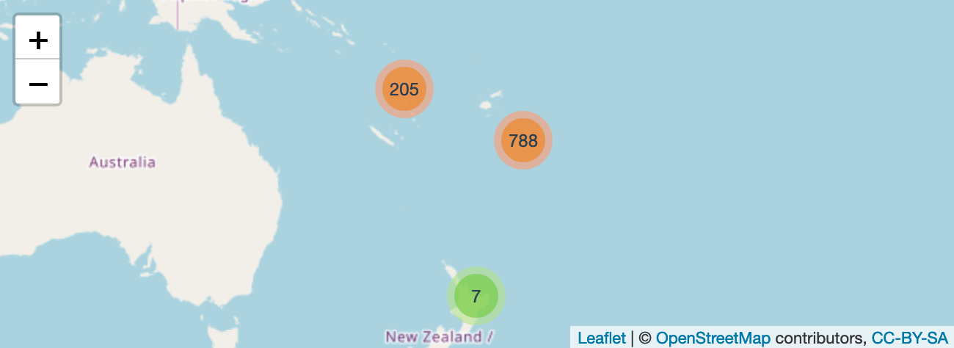
Clusters
leaflet(quakes) %>%
addTiles() %>%
addMarkers(
clusterOptions = markerClusterOptions()
)

Slide 26
Why clusters?
Sometimes there’s just a ton of data to show and trying to visualize them will bring any browser window it a crawl.
Example: https://pittsburghpa.shinyapps.io/TreesNAt/

Slide 27
exercise
Go to leaflet_exercises.Rmd clusters code chunk
Use 311 data to create a cluster map
Create a factor palette
Create a legend
Make sure to include a basemap
Hint: https://rstudio.github.io/leaflet/markers.html

Slide 28
Solution
Go to leaflet_exercises_solutions.Rmd

Slide 29
leaflet
.extras

Slide 30
Leaflet.extras
Adds some pretty nice functions to complement leaflet
Tile caching: http://rpubs.com/bhaskarvk/TileLayer-Caching
weather icons: http://rpubs.com/bhaskarvk/leaflet-weather
Pulse icons: http://rpubs.com/bhaskarvk/leaflet-pulseIcon
and heat maps!

Slide 31
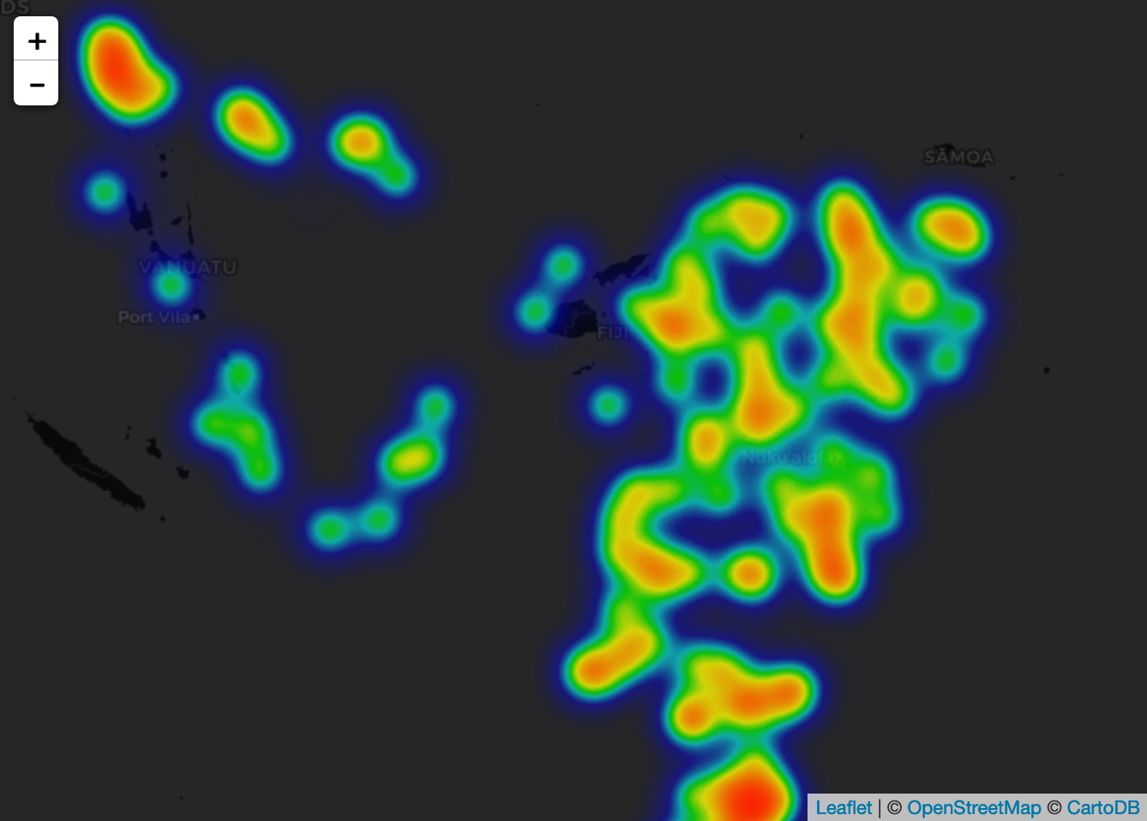
leaflet(quakes) %>%
addProviderTiles(providers$CartoDB.DarkMatter) %>%
setView( 178, -20, 5 ) %>%
addHeatmap(lng = ~long, lat = ~lat, intensity = ~mag,
blur = 20, max = 0.05, radius = 15)

Slide 32
exercise
Using the pothole data create a heat map
This won’t be very different from your cluster map from before.
Play around with the arguments for heat maps and find a good radius that looks good.
Compare your settings with your neighbor

Slide 33
Leafletproxy
Shiny from

Slide 34
Leaflet
In Shiny

Slide 35
Just like any other output
You need a render function and a subsequent output in the UI
Reacts to reactive functions and inputs like any other plot
However, it will take much longer to render than a typical ggplot2 graph.

Slide 36
What we know about reactivity

Slide 37
review: observers
Use to execute actions based on changing reactive values and other reactive expressions.
Doesn't return a value. So performing side effects is usually the only reason you'd want to create one of these.
Eagerly executed by Shiny.
observe({
print(paste("The value of x is", input$x))
})
## [1] The value of x is 10
## [1] The value of x is 16
## [1] The value of x is 9

Slide 38
Observers in leaflet
Observers in leaflet can do a number of thing
Move the map (fitBounds, )
Remove specific markers/shapes/lines (removeShape…)
Remove entire groups
Change the basemap
And more!

Slide 39
Leaflet proxy
Inside an observer target the map with the leafletProxy() function
Clear the group before re-adding it
Note: This doesn’t really work well with clusterOptions.
leafletProxy("map") %>% # this should be the main map id
clearGroup(“groupName”) %>%
addMarkers(markersReactive(), group = “groupName" …)

Slide 40

exercise
Open /apps/green_inf.R
Right now this application re-runs the entire map every time a change is made to an input.
Make a new observer expression that only edits the layer of green infrastructure projects, and does not reload the entire map itself.

Slide 41
Solution
apps/green_inf_proxy_01.R

Slide 42
What about shapes?
You can do this with shapes too!
It works the same way as points. This is also true for any other layer type, lines, heat maps etc.

Slide 43
exercise
Open /apps/green_inf_proxy_01.R
Add a new reactive expression that selects the polygon of the selected borough
Add a new observer that adds the selected borough to the map as well.

Slide 44
Solution
apps/green_inf_proxy_02.R

Slide 45
Inputs and
Events

Slide 46
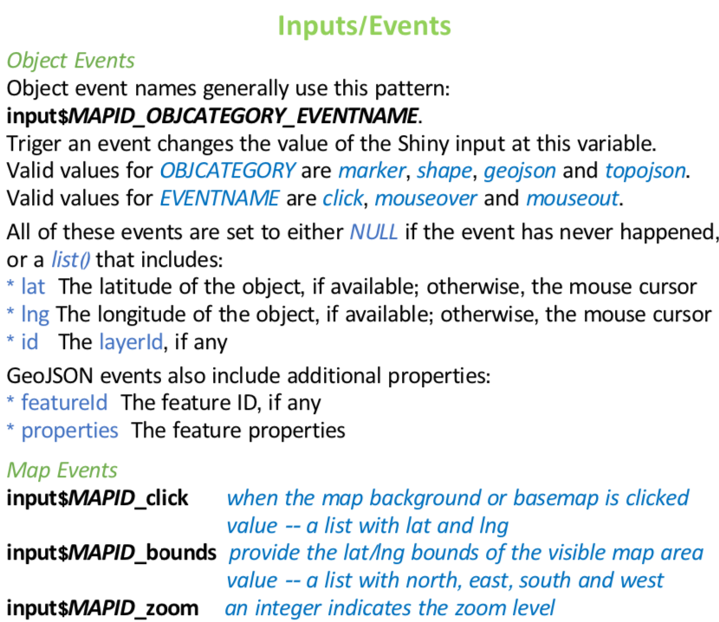
Uses for inputs
Sometimes you might need to have things happen based off of user inputs or map bounds
Charts showing information based off of what is within the map bounds
Showing details/plots of a selected item
leaflet.pdf cheatsheet

Slide 47
Inputs generated
In all of these examples “leaflet” is whatever you called your (ie: output$leaflet). These are the kinds of things you may want to hide from your bookmarking.
input$leaflet_center
$lat, $lng
input$leaflet_zoom
input$leaflet_bounds
$north, $east, $south, $west
input$leaflet_marker_mouseout$
$id, $group, $lat, $lng
input$leaflet_marker_click$
$id, $group, $lat, $lng
input$leaflet_groups (list of active group names)

Slide 48
demo
http://shiny.rstudio.com/gallery/superzip-example.html

Slide 49
Using proxy
Unlike ggplot2 compute time for a leaflet map is time consuming.
The leafletProxy function and observers allow us to only change the parts of the map that are necessary
This saves computing power and speeds up rendering
It also keeps the user from having to deal with a resetting map

Slide 50
exercise
Open apps/green_inf_proxy_02.R
Let’s create a UI element that shows the user the number of projects they are viewing.
Hint: Check the code from superzip and see how they used the bounds input
Note: I added some lines to this app that creates the coordinates as variables in the @data frame.

Slide 51
Solution
apps/green_inf_proxy_03.R

Slide 52
Reactive Values review
Like an R environment object (or what other languages call a hash table or dictionary), but reactive
Like the input object, but not read-only
rv <- reactiveValues(x = 10)
rv$x <- 20
rv$y <- mtcars

Slide 53
Reactive Values Review cont.
Reading a value from a reactiveValues object is a reactive operation.
The act of reading it means the current reactive conductor or endpoint will be notified the next time the value changes.
Maybe surprisingly, setting/updating a value on a reactiveValues object is not in itself a reactive operation, meaning no relationship is established between the current reactive conductor or endpoint (if any!) and the reactiveValues object.

Slide 54
exercise
Open /apps/green_inf_proxy_03.R
Add a reactive list to store removed projects
Edit the reactive expression to remove projects that have been removed by the user
Hint: append stored values in a reactive list
Stretch Goal: add a function that restores the

Slide 55
Solution
apps/green_inf_proxy_04.R

Slide 56
Other concepts to recall
Refresh limits on LeafletProxy maps are a very good idea
Keep in mind that add ons like layer controls mean you don’t have to build tons of functionality into your app
You can target individual shapes if you give them an id, just like row number in DT package

Slide 57
Leafletproxy
Shiny from

Slide 58

Homework
Project 2

